Slide 1
3GPP 5G Technology and Self Evaluation Results
Wu Yong
3GPP Rapporteur of IMT-2020 self-evaluation
wuyong@huawei.com

Slide 2
Table of contents
1
2
3
4
3GPP 5G development and submission towards IMT-2020
3GPP 5G technology for IMT-2020
3GPP 5G self evaluation towards IMT-2020
Conclusion

Slide 3
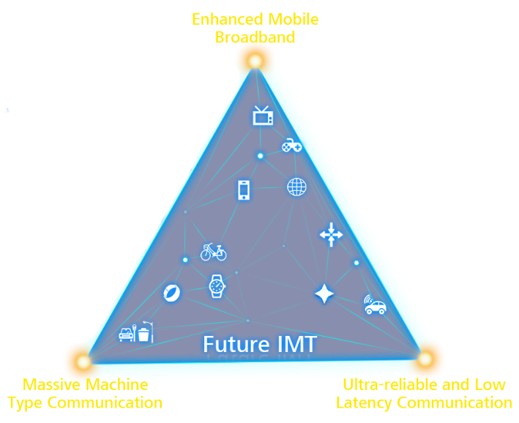
ITU-R IMT-2020 vision: Extend Radio to industries
Enhance Mobile Broadband eMBB
User Experienced
Data Rate
Peak Data Rate
eMBB
Area Traffic Capacity
Spectrum Efficiency
IMT-2020
Vision
Rec. ITU-R M.2083
Network Energy Efficiency
Mobility
mMTC
URLLC
mMTC
Massive Machine Type Communications
URLLC
Ultra-Reliable and
Low Latency Communications
Connection Density
Latency
IMT-2020 usage scenario
IMT-2020 Key capabilities
Diverse services
Diverse requirements
3GPP “5G” aims to meet ITU-R’s IMT-2020 vision capabilities

Slide 4
3GPP 5G development timeline
2017
2018
2019
2020
Q4
Q1
Q2
Q3
Q4
Q1
Q2
Q3
Q4
Q1
Q2
Rel-15 NSA (option-3) freeze
Rel-15 NSA (option-3) ASN.1
“Main drop”
Rel-15 freeze (incl 5G SA)
Rel-15 ASN.1 (incl 5G SA)
“Late drop”
“Early drop”
Rel-15 late drop freeze
Rel-15 late drop ASN.1
Rel-16 Study phase
Rel-16 Study and Normative phase
Rel-16 freeze
Rel-16 ASN.1

Slide 5
3GPP 5G submission towards ITU-R
Name : 5G
Footnote: Developed by 3GPP as 5G, Release 15 and beyond
Submission 1: SRIT
Component RIT: NR
Component RIT: EUTRA/LTE
incl. standalone LTE, NB-IoT, eMTC, and LTE-NR DC
full 38 and 36 series, and subset of 37 series
Submission 2: NR RIT
We are Here
3GPP provided complete submission templates to WP 5D#33 and acknowledgement is received.

Slide 6
Table of contents
2
1
3
4
3GPP 5G development and submission towards IMT-2020
3GPP 5G technology for IMT-2020
3GPP 5G self evaluation towards IMT-2020
Conclusion

Slide 7
3GPP 5G: NR key technical characteristics
Flexible
frame structure
Flexible
spectrum utilization
Massive MIMO
D
D
D
S
U
D
D
D
S
U
TDD
…
SUL
FDD
Forward compatibility
Minimize always-on transmissions
Avoid static/strict timing relations
Keep control channel together with data channel in frequency domain
Reserved resources

Slide 8
3GPP 5G: NR flexible frame structure
Flexible Frame structure
NR supports reduced guard band ratio with large component carrier bandwidth
NR Multiple SCSs enable reduced slot durations
NR PDSCH can reuse resources unused by NR PDCCH, saving large overhead especially in large bandwidth
SCS | Guard band ratio
15kHz | 10MHz BW: 6.4% | 40 MHz BW: 2.8%
30kHz | 20 MHz BW: 8.2% | 100 MHz BW: 1.7%
60kHz | 40 MHz BW: 8.2% | 100 MHz BW: 2.8%
SCS (kHz) | Slot duration | SCS (kHz) | Slot duration
15 | 1ms | 60 | 0.25ms
30 | 0.5ms | 120 | 0.125ms
Figure source: RWS-180007, NR Physical Layer Design: Physical layer structure, numerology and frame structure, Havish Koorapaty, Ericsson

Slide 9
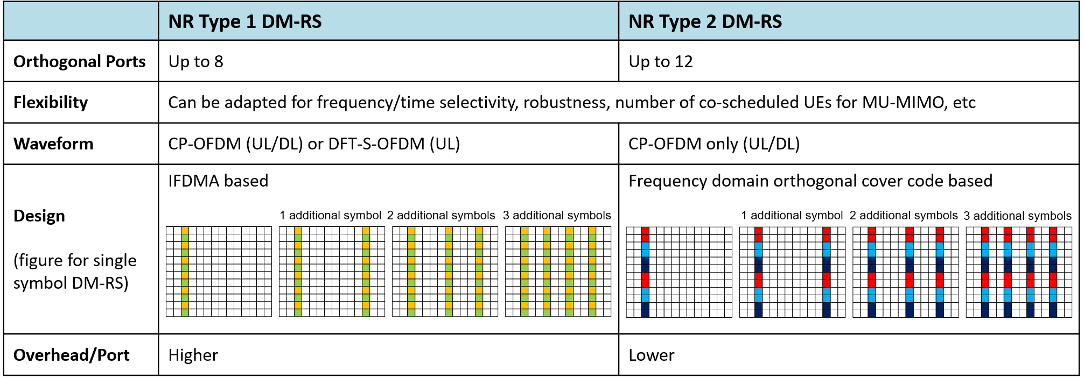
3GPP 5G: NR Massive MIMO
Massive MIMO
NR Type-I codebook design
NR Type-II codebook design
NR supports up to 32 gNB ports codebook for FDD; and larger than 64 gNB ports for TDD
NR supports 12 orthogonal DM-RS ports for MU pairing, as compared to 4 orthogonal UE specific RS ports in LTE
NR overhead reduction for reference signals (RS): DMRS overhead reduction for DL/UL compared to LTE-A; no CRS.
…
…
NR Type I/II codebook
…
…
NR DM-RS design
Source: RWS-180008, NR Physical Layer Design: NR MIMO, Younsun Kim, Samsung

Slide 10
3GPP 5G: NR flexible spectrum utilization
Flexible spectrum utilization
FR1 (450MHz – 6GHz)
FR2 (24.25GHz – 52.6GHz)
4.495
1.427
4.8
1.518
3.4
3.6
24.25
27.5
37
40.5
42.5
43.5
45.5
47
48.2
50.4
52.6
66
71
0.091
0.2
3.25
3.5
2
1.5
2.2
(GHz)
NR supports up to 16 carrier aggregation and bandwidth part. Max BW of each carrier is 100 MHz (FR1) or 400 MHz (FR2).
NR supports FDD and semi-statically configuration of UL/DL split in TDD
NR supports operating on a TDD band with supplementary uplink (SUL) band
1
1
5
1.4GHz
3.5GHz
4.5GHz
20GHz
30GHz
40GHz
50GHz
60GHz
70GHz
80GHz
90GHz
[IMT Spectrum]
[WRC-19 IMT spectrum] (24.25-27.5), (37-40.5), (40.5-42.5), (42.5-43.5), (45.5-47), (47.2-48.2), (66-71)GHz
 | SCS [kHz] | Maximum aggregated bandwidth (MHz)
FR1 | 15 | 800
 | 30 | 1600
 | 60 | 1600
FR2 | 60 | 3200
 | 120 | 6400
Spectrum utilization for FR1
SCS (kHz) | 5 MHz | 10 MHz | 15 MHz | 20 MHz | 25 MHz | 30 MHz | 40 MHz | 50 MHz | 60 MHz | 70 MHz | 80 MHz | 90 MHz | 100 MHz
 | N_{RB} | N_{RB} | N_{RB} | N_{RB} | N_{RB} | N_{RB} | N_{RB} | N_{RB} | N_{RB} | N_{RB} | N_{RB} | N_{RB} | N_{RB}
15 | 25 | 52 | 79 | 106 | 133 | 160 | 216 | 270 | N.A | N.A | N.A | N.A | N.A
30 | 11 | 24 | 38 | 51 | 65 | 78 | 106 | 133 | 162 | 189 | 217 | 245 | 273
60 | N.A | 11 | 18 | 24 | 31 | 38 | 51 | 65 | 79 | 93 | 107 | 121 | 135
Source: RWS-180011, NR Radio Frequency and co-existence, Xutao Zhou, Samsung
Bandwidth part
SUL
Single cell for TDD+SUL
TDD
D
D
NR TDD band (e.g., 3.5GHz)
D
S
U
D
D
D
S
U
NR SUL band (e.g., 1.8GHz)
TDD
SUL
Figure source: RWS-180007, NR Physical Layer Design: Physical layer structure, numerology and frame structure, Havish Koorapaty, Ericsson
Figure source: RWS-180018, Self evaluation: Enhanced Mobile Broadband (eMBB) Evaluation results, Wu Yong, Huawei

Slide 11
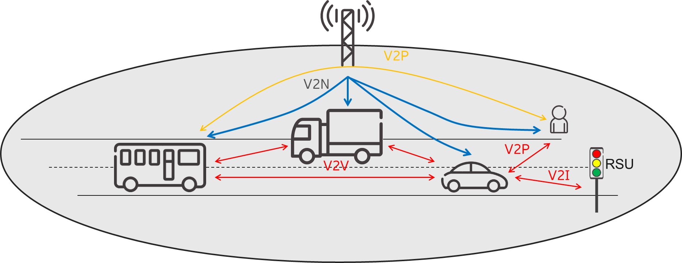
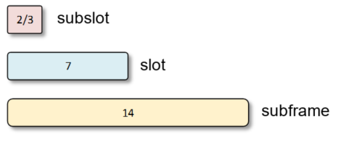

3GPP 5G: LTE evolution
Elevation Beamforming/ Full-Dimension MIMO
Proximity services (ProSe) and vehicle-to-everything (V2X)
Shortened TTI and processing time
… …
Increased number CSI-RS ports to 12 and 16
Beam selection
SRS enhancements for low delay spread channels
DMRS enhancements to increase the number of co-scheduled UEs
UE-autonomous and NW-managed resource allocation for sidelink
Distributed synchronization for no network coverage
New physical layer format for high mobility scenarios (V2X)
New cellular multicast periodicities for reduced latency
Shortened TTI and processing time for LTE, possibility for subslot- (2 or 3 symbols long) and slot-based transmission.
A shortened processing time of n+3 (compared to n+4) for subframe-based transmissions
Source: RWS-180013, LTE evolution, Asbjörn Grövlen, Ericsson

Slide 12
3GPP 5G: NB-IoT and eMTC
NB-IoT
eMTC
15 kHz
3-tone
180 kHz
×12
1-tone
…
3-tone
15 kHz
15 kHz
1.4 MHz
180 kHz
×12
LTE subcarrier spacing
…
6-tone
6-tone
15 kHz
12-tone
180 kHz
3.75 kHz
LTE subcarrier spacing
×48
…
Single-tone and 3/6/12-tone UL allocations
3.75 kHz
3- and 6-tone allocations within a PRB of a 1.4 MHz bandwidth
Dense subcarrier spacing
…
DATA
DATA
DATA
DATA
DATA
DATA
DATA
DATA
DATA
DATA
PSD
Non-anchor carriers for capacity and load-balancing
DATA
DATA
DATA
DATA
DATA
DATA
NB-IoT
LTE
eMTC
DATA
DATA
DATA
DATA
DATA
DATA
DATA
DATA
DATA
DATA
f
Source: RWS-180023, 3GPP’s Low-Power Wide-Area IoT Solutions: NB-IoT and eMTC, Matthew Webb, Huawei
PSD boost in bandwidth as small as 3.75 kHz
…

Slide 13
3GPP 5G architecture
Option 2 NR Standalone; NR-NR DC
Option 4 “NE-DC”
Option 5 LTE to 5GC
Option 7 “NGEN-DC”
Option 3 “EN-DC”
“LTE eNB” as Master Node (MN), connected to LTE core network
“NR gNB” as Secondary Node (SN)
“NR gNB” as MN, connected to 5G core network
“NR gNB” or “LTE eNB” as SN
“LTE eNB” as MN, connected to 5G core network
“NR gNB” as SN
Source: RWS-180009, NR Architecture, Gino Masini, Ericsson
3GPP provided multiple options for smooth migration to 5G based on operator’s strategies.

Slide 14
Table of contents
3
1
2
4
3GPP 5G development and submission towards IMT-2020
3GPP 5G technology for IMT-2020
3GPP 5G self evaluation towards IMT-2020
Conclusion

Slide 15
3GPP submission templates
According to Report ITU-R M.2411 “Requirements, Evaluation criteria, and submission templates for the development of IMT-2020”.
3GPP provided the following submission templates and preliminary self evaluation
Description templates
Compliance templates
Self evaluation report TR37.910v16.1.0
Characteristics templates
For SRIT (NR+LTE)
For NR RIT
Compliance templates
For SRIT (NR+LTE)
For NR RIT
On
Service, Spectrum and Technical performance requirement
Based on evaluation guidelines defined in Report ITU-R M.2412.
Evaluation results for Rel-15/16
NR RIT: 5 test environments for eMBB, URLLC and mMTC
LTE RIT: Indoor/Dense Urban/Rural – eMBB and Urban Macro – mMTC
Link budget template
NR in 5 test environments,
LTE in 4 test environments
IMT-2020 submission

Slide 16
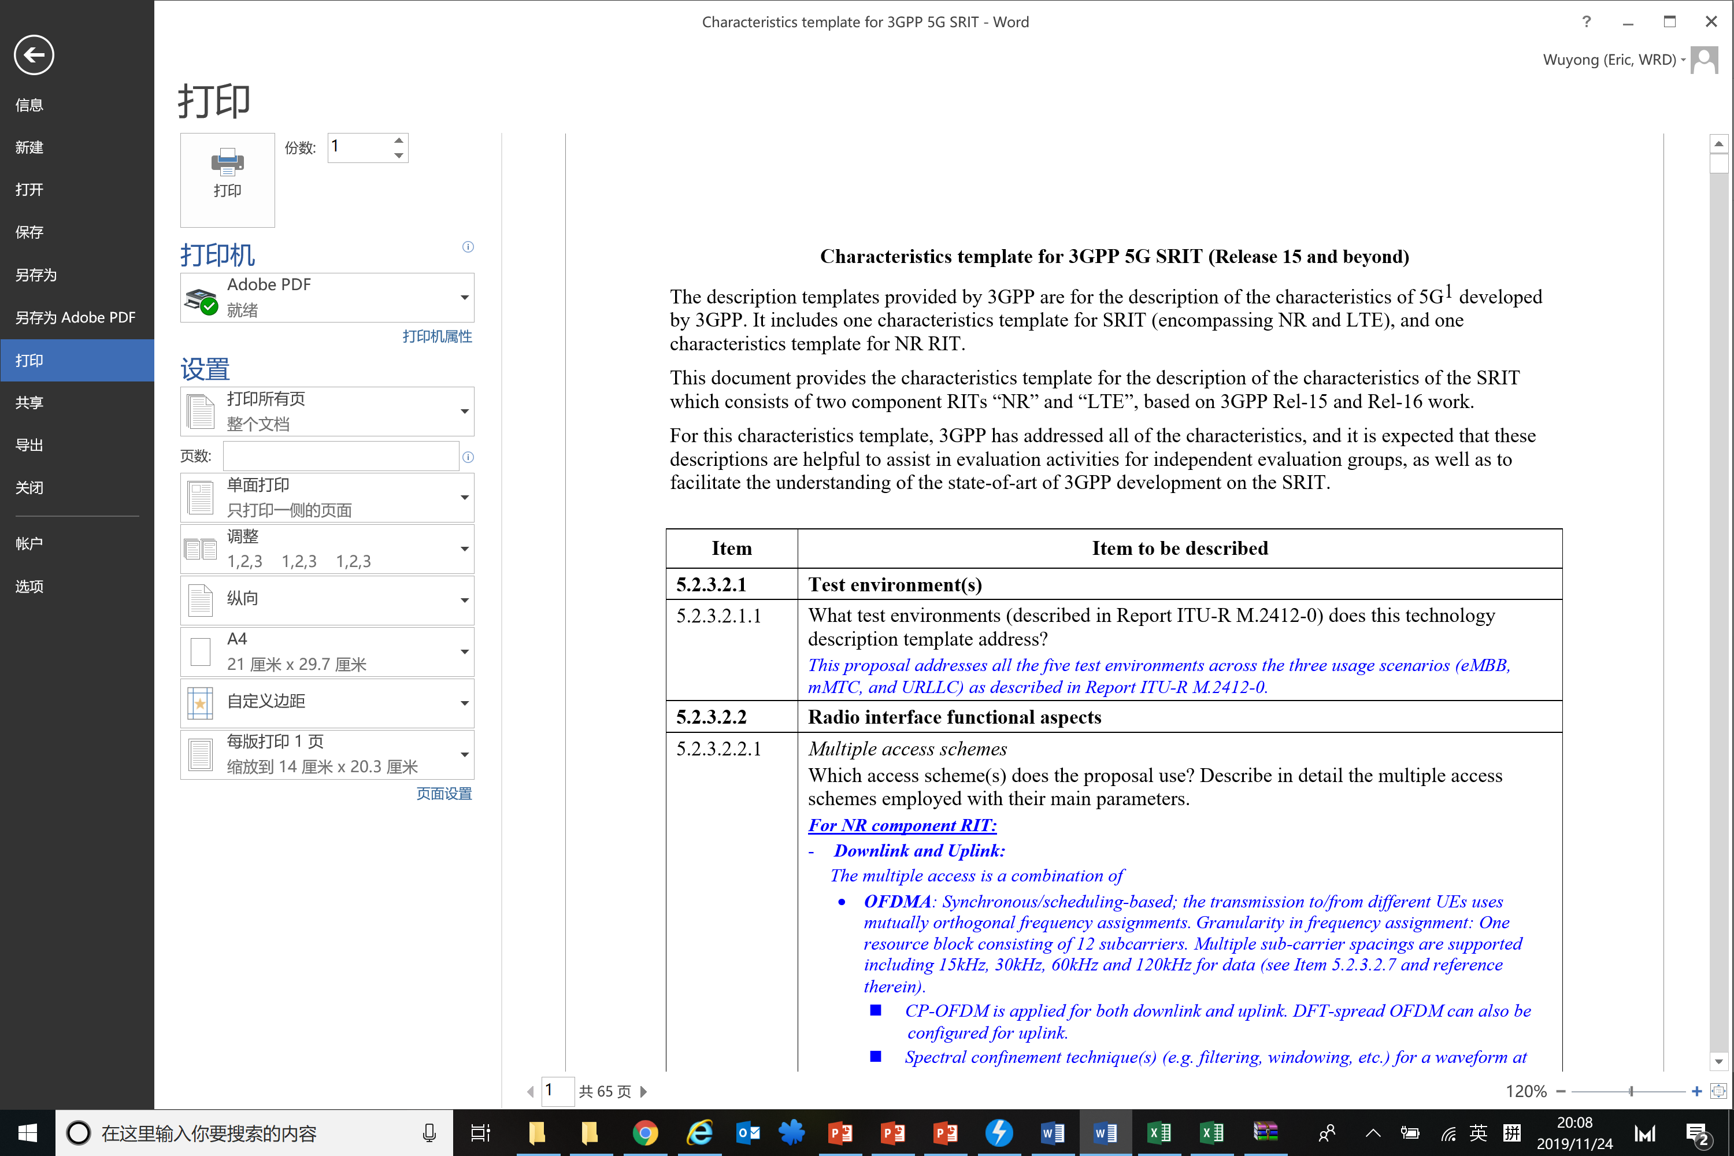
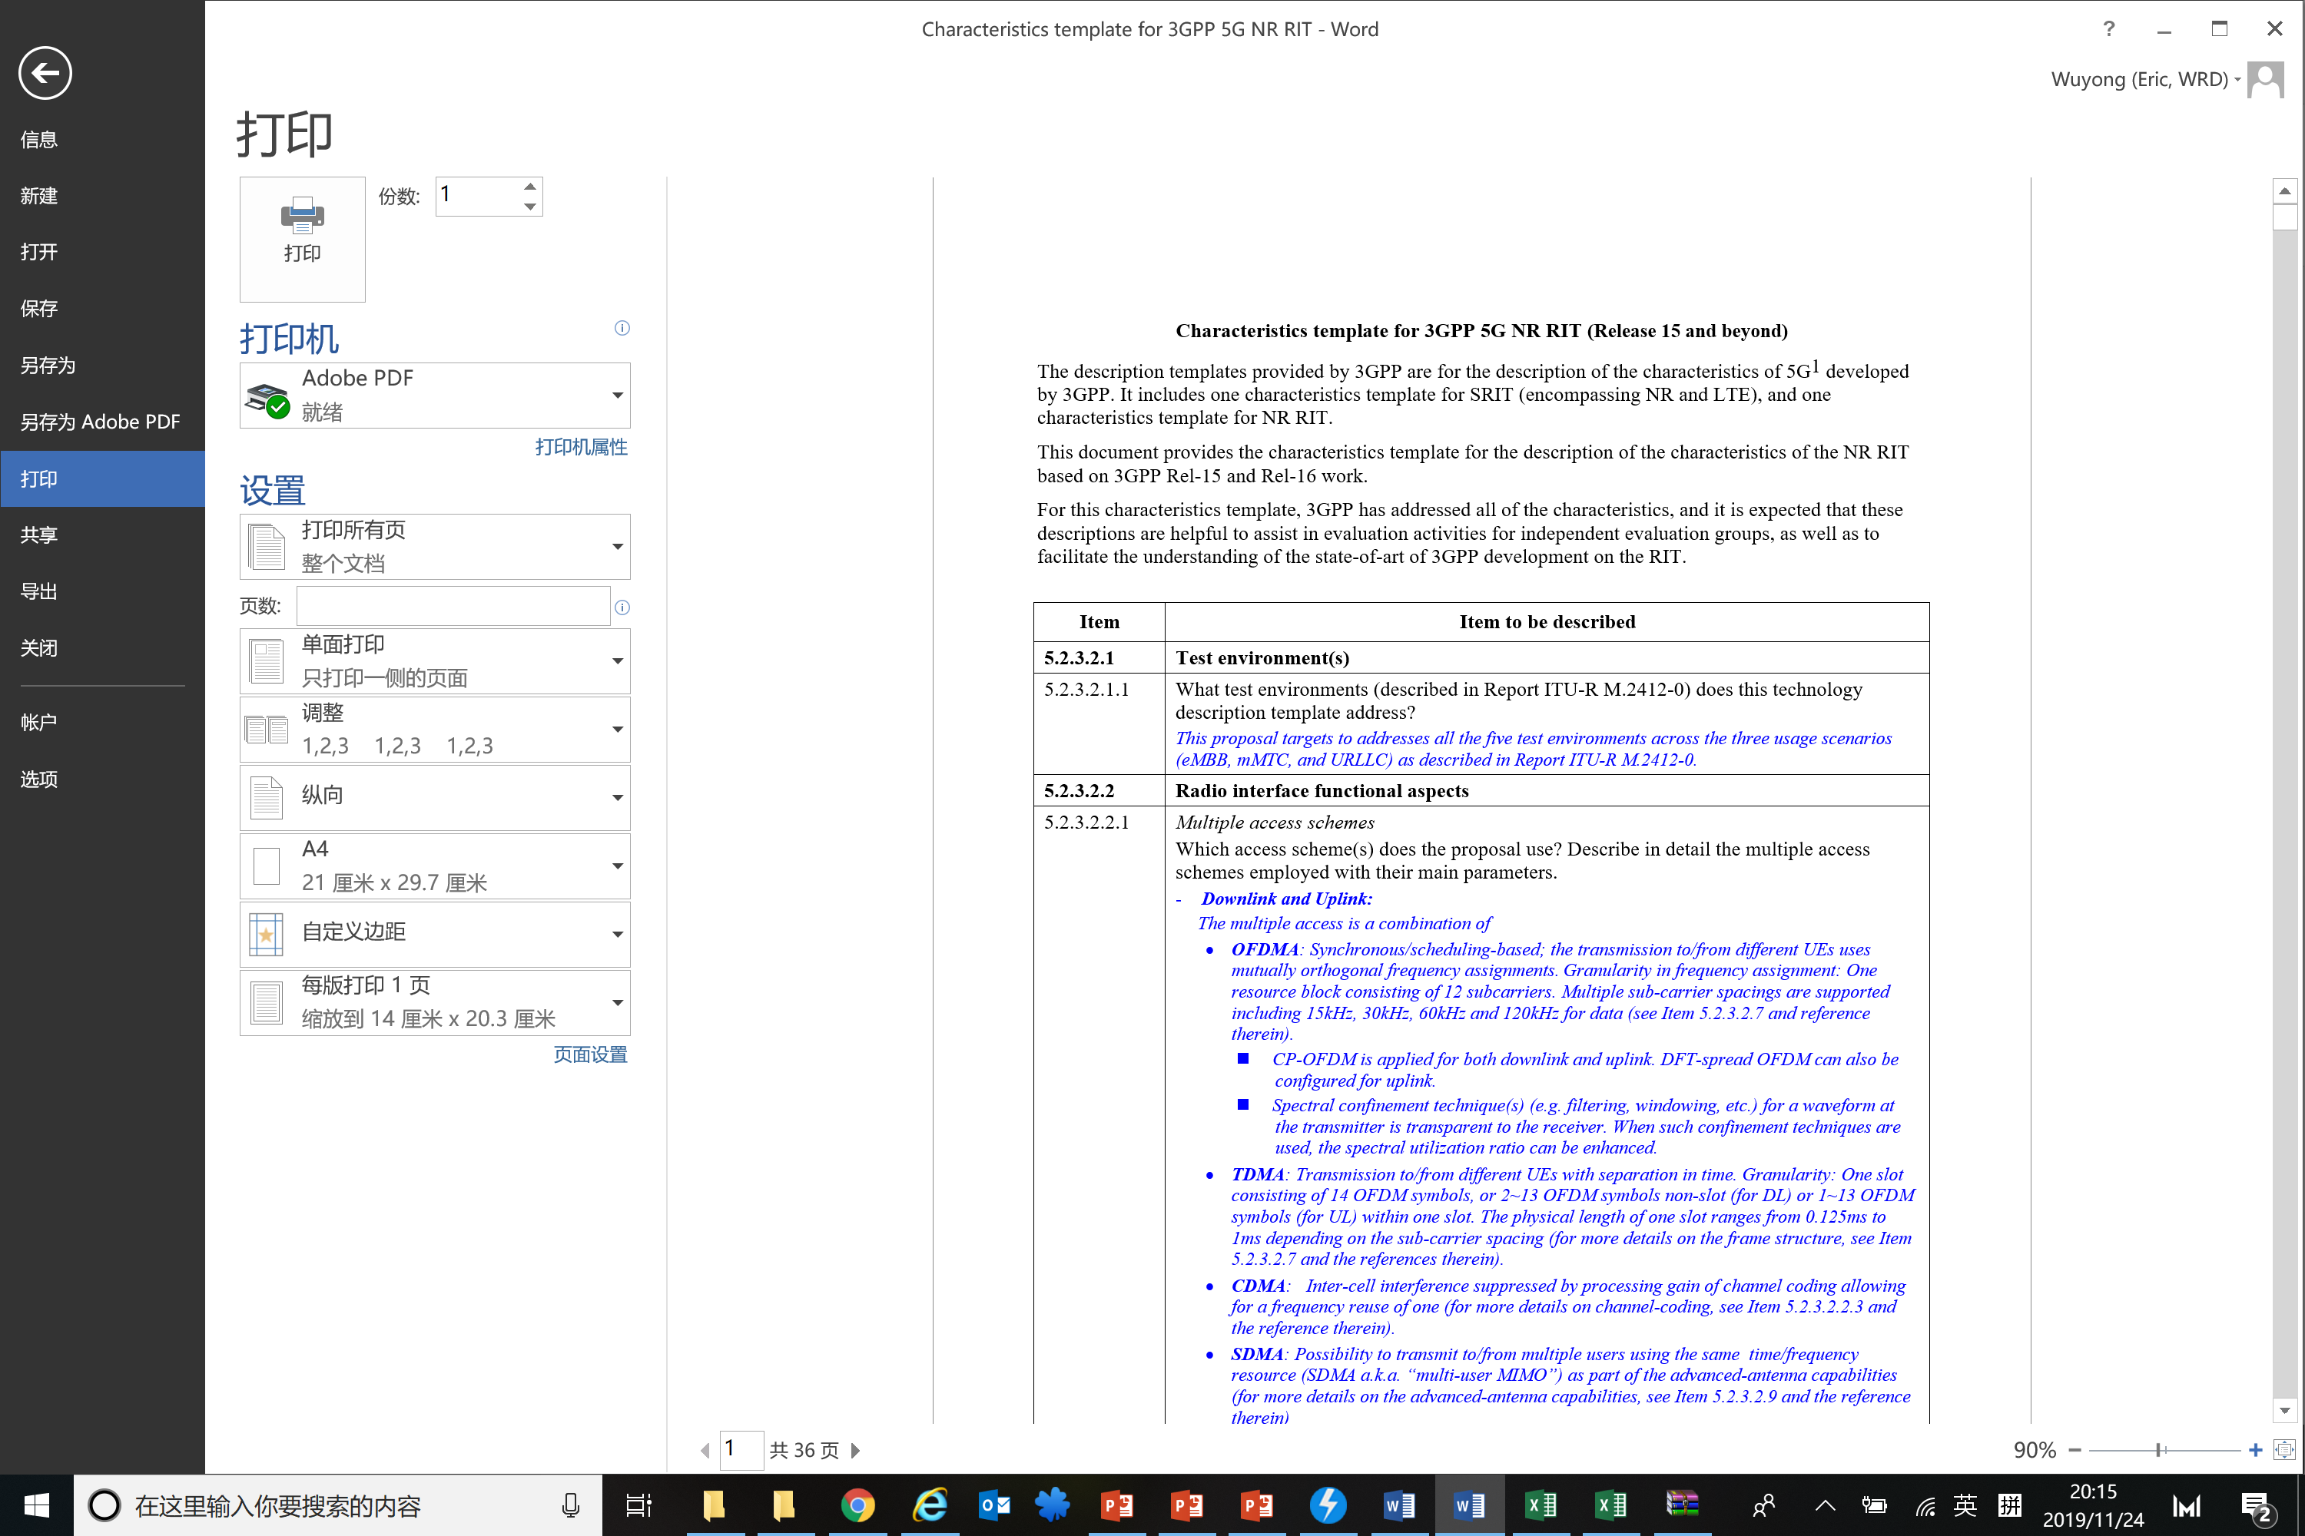
3GPP Submission Templates Description templates - Characteristics
3GPP provided characteristics description for SRIT (NR+LTE) and NR RIT for all items.
The description on new and key functionalities are the basis for ITU evaluation.
Test environment(s)
Radio interface functional aspects (multiple access, modulation, PAPR, coding scheme)
Channel tracking capabilities (e.g., pilot symbol configuration)
Physical channel structure and multiplexing
Mobility management (Handover)
Radio resource management
Frame structure
Spectrum capabilities and duplex technologies
Support of Advanced antenna capabilities
Link adaptation and power control
Power classes
Scheduler, QoS support and management, data services
Radio interface architecture and protocol stack
Cell selection
Location determination mechanisms
Priority access mechanisms
Unicast, multicast and broadcast
Privacy, authorization, encryption, authentication and legal intercept schemes
Frequency planning
Interference mitigation within radio interface
Synchronization requirements
Support for wide range of services
Global circulation of terminals
Energy efficiency
Other items

Slide 17
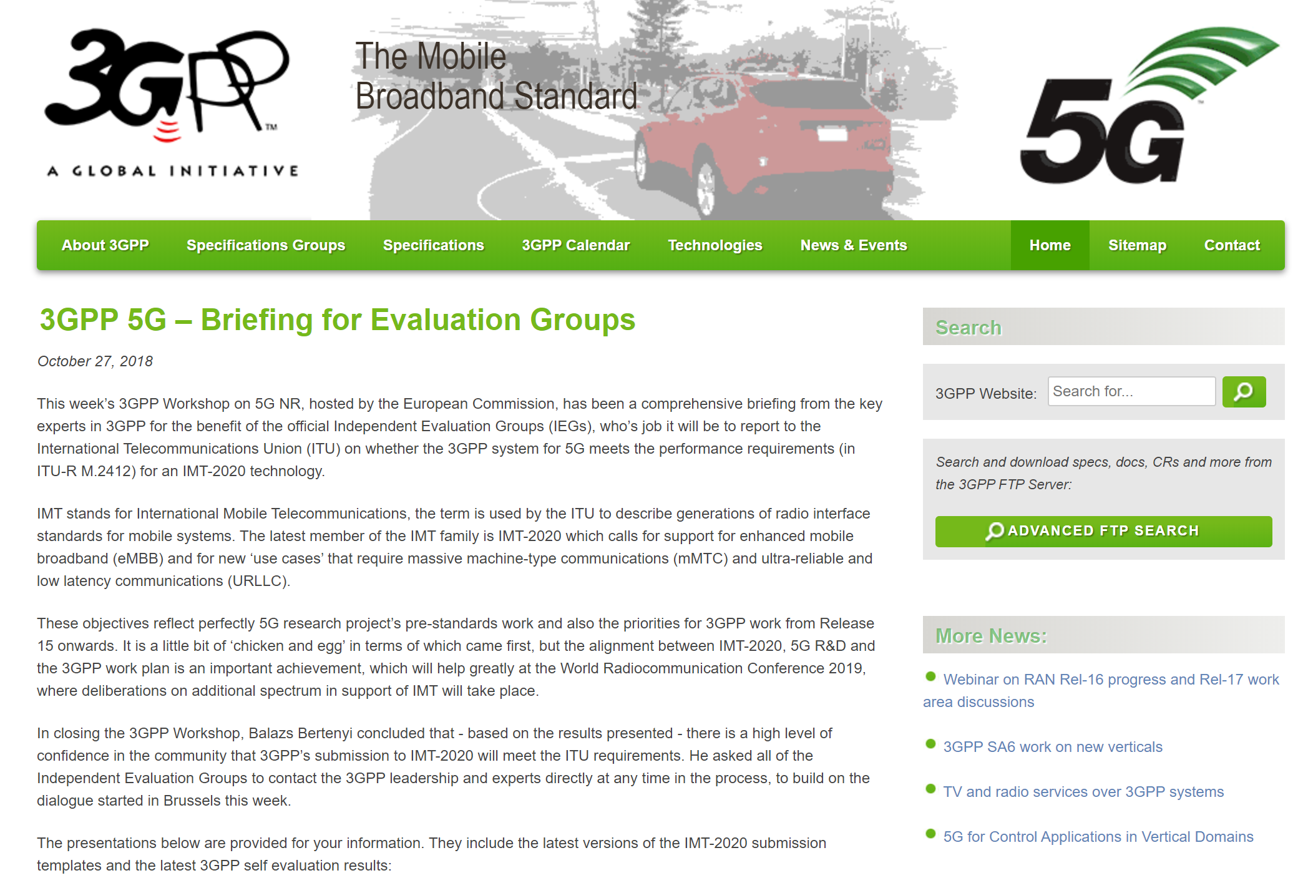
Characteristics Description: More references
Document
RWS-180004 | The 3GPP Submission
RWS-180005 | Overview of RAN aspects
RWS-180006 | System and Core Network Aspects
RWS-180007 | NR Physical Layer Design: Physical layer structure, numerology and frame structure
RWS-180008 | NR Physical Layer Design: NR MIMO
RWS-180009 | NR Architecture
RWS-180010 | NR Radio interface Protocols
RWS-180011 | NR Radio Frequency and co-existence
RWS-180023 | 3GPP’s Low-Power Wide-Area IoT Solutions: NB-IoT and eMTC
RWS-180013 | LTE evolution

Slide 18
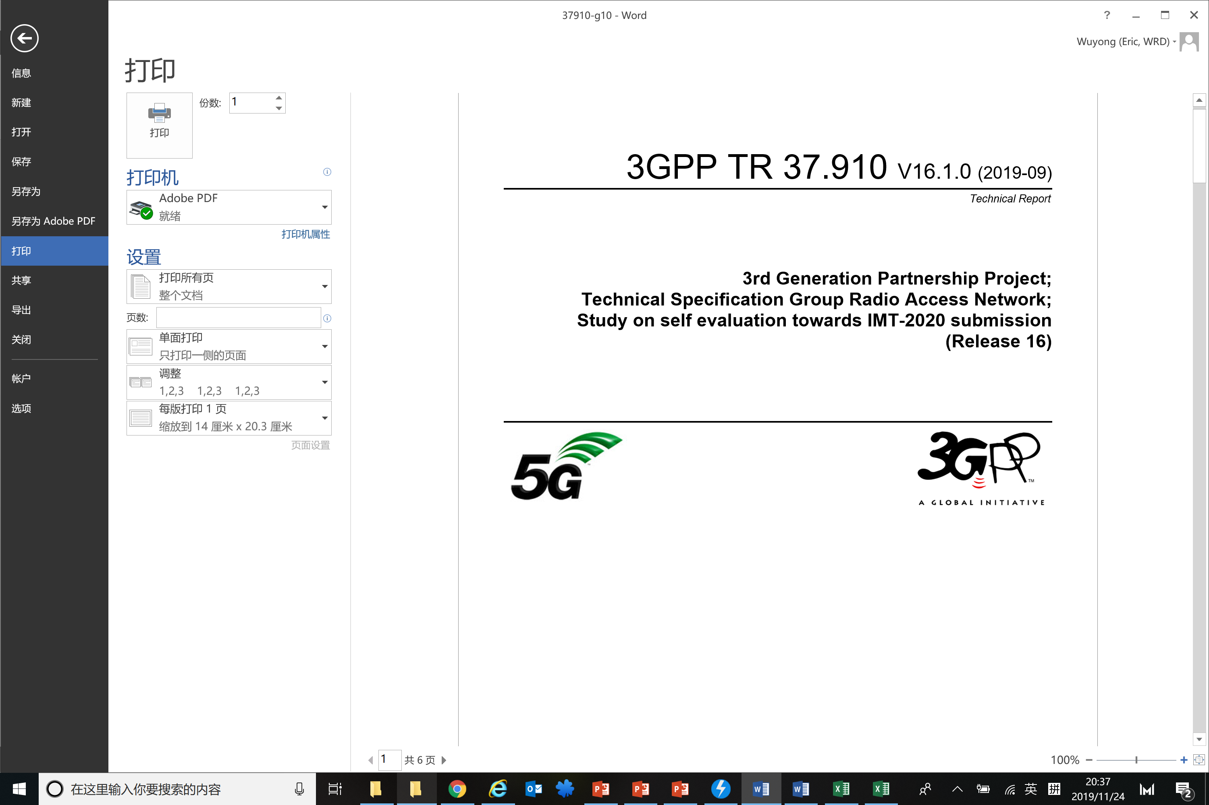













Self evaluation report TR 37.910
TR 37.910 v16.1.0 provides the full assessment of 3GPP 5G towards IMT-2020 requirements
 | NR | LTE
Indoor Hotspot | ✓ | ✓
Dense Urban | ✓ | ✓
Rural | ✓ | ✓
eMBB
Future IMT
mMTC
URLLC
 | NR | LTE
Urban Macro | ✓ | ✓
 | NR | LTE
Urban Macro | ✓ | N/A

Slide 19
Peak spectral efficiency
Peak spectral efficiency:
DL: 8 layer for FR1; 6 layer for FR2; 256QAM (NR, LTE) / 1024QAM (LTE), max code rate = 0.9258 (NR) / 0.93 (LTE)
UL: 4 layer, 256QAM, max code rate = 0.9258 (NR) / 0.93 (LTE)
DL peak spectral efficiency (bit/s/Hz)
Contributing technical components:
NR large CC bandwidth introduces reduced guard band ratio
NR small overhead for DL:
For PDCCH, as low as 0.6%@100 MHz for low load; 8-layer DMRS overhead reduced to 9.5%; no CRS
NR small overhead for UL:
4-layer DMRS overhead reduced to 7% under UL OFDMA; “Special subframe” can be used to transmit UL data -> Overhead reduced.
… …
UL peak spectral efficiency (bit/s/Hz)

Slide 20
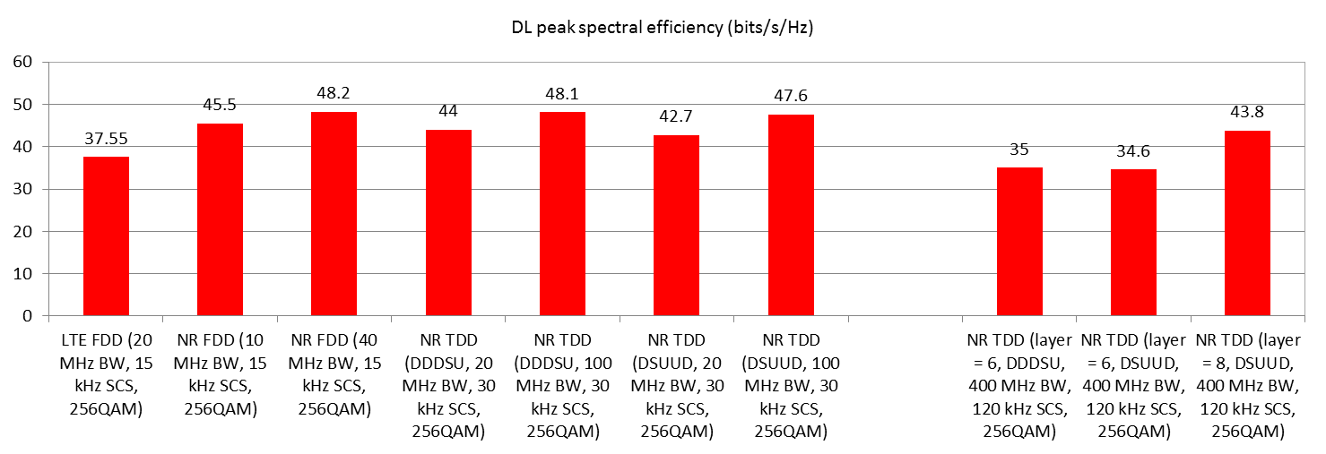
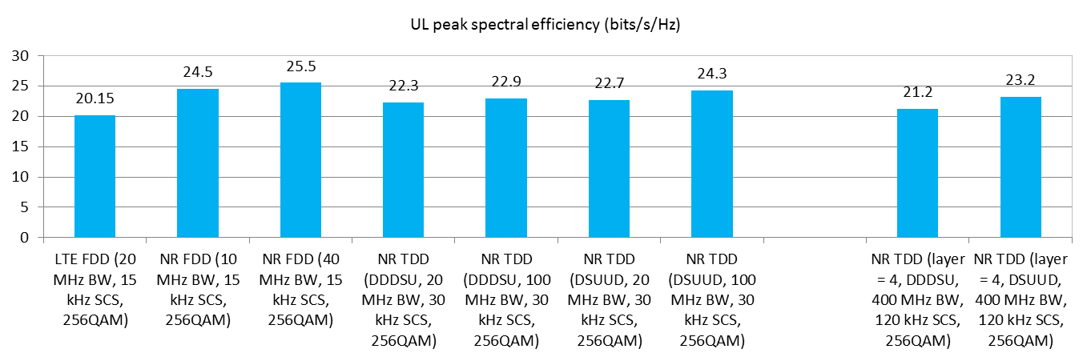
Peak spectral efficiency
Various NR/LTE configurations are evaluated; see Section 5.1 of TR37.910 for details.
FR1
FR2

Slide 21
Peak data rate
NR Peak data rate (Gbit/s)
Peak data rate:
NR Max aggregated bandwidth :
FR1 (15 kHz SCS): 16 CC x 50 MHz/CC = 800 MHz
FR1 (30/60 kHz SCS): 16 CC x 100 MHz/CC = 1.6 GHz
FR2 (120 kHz SCS): 16 CC x 400 MHz/CC = 6.4 GHz
LTE Max aggregated bandwidth:
32 CC x 20 MHz/CC = 640 MHz
Peak data rate =
(Peak SE) x (Aggregated bandwidth)
DL
UL
For various NR configurations
LTE Peak data rate (Gbit/s)
DL
UL
For LTE FDD (256QAM) with 640 MHz BW

Slide 22
Average and 5th percentile user SE
Contributing technical components for DL:
NR frame structure:
NR large CC bandwidth introduces reduced guard band ratio
NR PDCCH and PDSCH sharing allows overhead reduction, especially in large CC bandwidth
NR Massive MIMO:
NR Type II codebook and 12 orthogonal DMRS enhances MU-MIMO spectral efficiency especially for FDD
NR fast CSI feedback and SRS capacity enhancement improves MU-MIMO spectral efficiency especially for TDD.
… …
Contributing technical components for UL:
NR large CC bandwidth introduces reduced guard band ratio
NR DMRS overhead reduction for UL OFDMA compared to LTE-A
NR SRS capacity enhancement accelerates UL CSI derivation
NR OFDMA enables flexible and efficient resource allocation
… …
2 OS for 10MHz
NR PDCCH overhead reduction for large bandwidth
1 OS for 20MHz
0.5 OS for 40MHz

Slide 23
Average and 5th percentile user SE
NR evaluation results for Dense Urban:
Larger CC bandwidth brings improved SE (~30%) due to guard band ratio reduction and PDCCH overhead reduction
NR Massive MIMO: 64 TXRU brings additional gain over 32 TXRU in TDD.
NR DL average spectral efficiency (bit/s/Hz/TRxP)
NR DL 5th percentile spectral efficiency (bit/s/Hz)
Dense Urban (4 GHz)
Dense Urban (4 GHz)

Slide 24
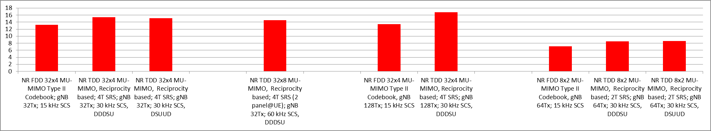
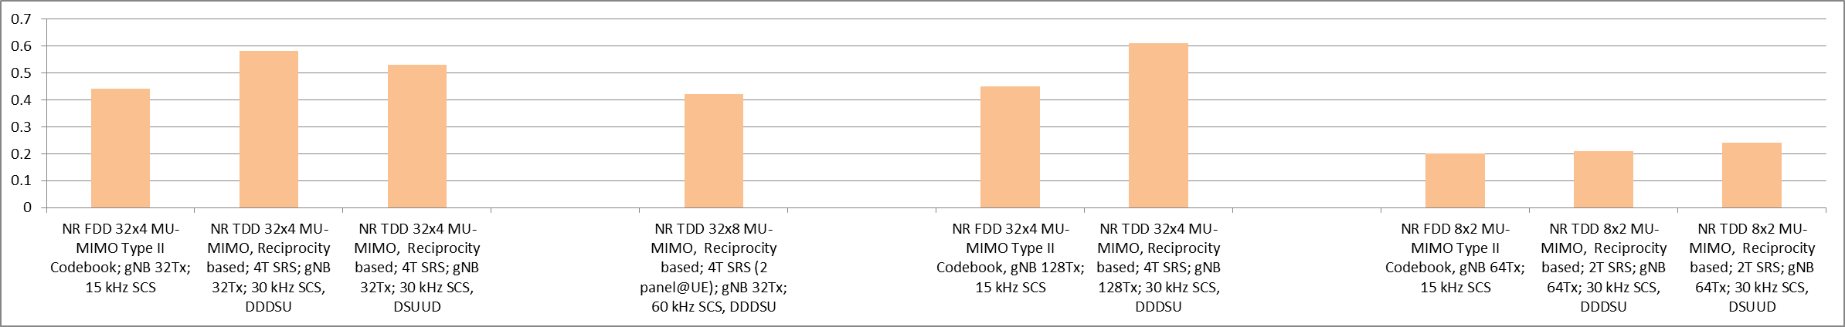
Average and 5th percentile user SE
Various NR configurations are evaluated. See Section 5.4 of TR37.910 for details
NR DL average spectral efficiency (bit/s/Hz/TRxP)
InH (4 GHz)
InH (30 GHz)
Dense Urban (4 GHz)
Rural (700 MHz)
NR DL 5th percentile user spectral efficiency (bit/s/Hz)

Slide 25
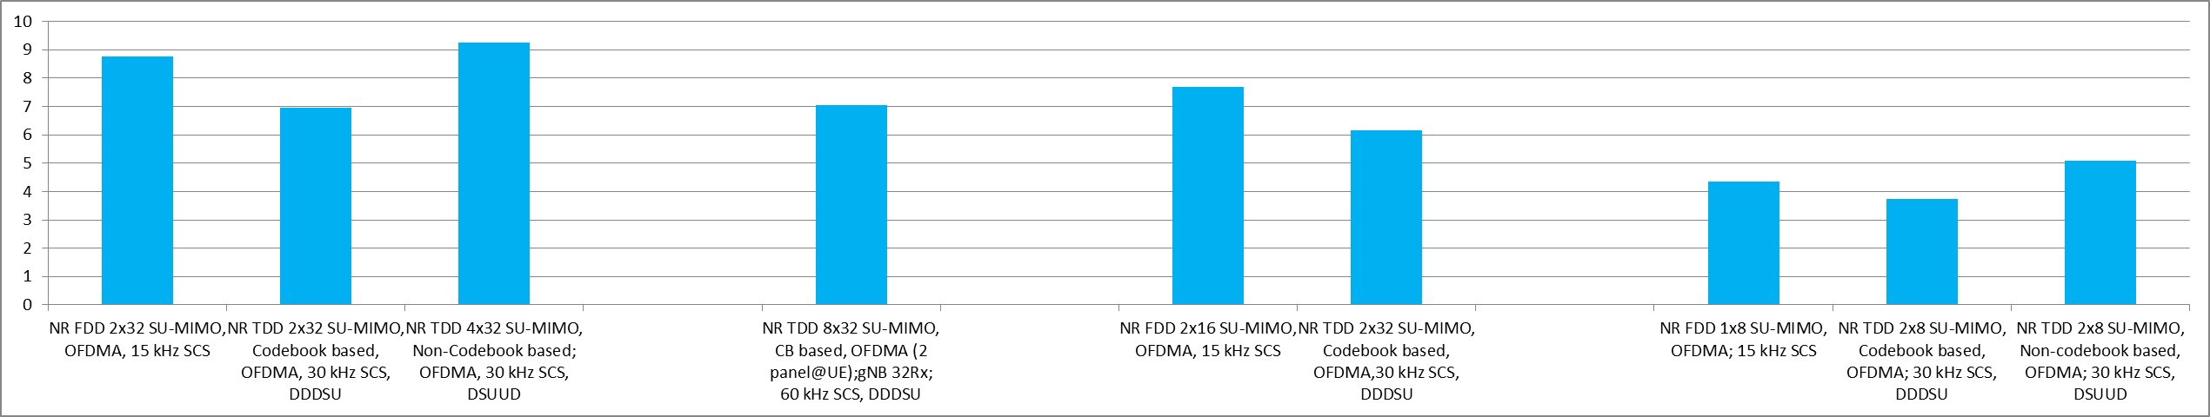
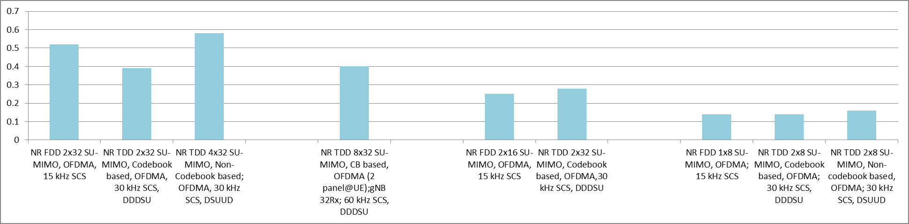
Average and 5th percentile user SE
Various NR configurations are evaluated. See Section 5.4 of TR37.910 for details
NR UL average spectral efficiency (bit/s/Hz/TRxP)
InH (4 GHz)
InH (30 GHz)
Dense Urban (4 GHz)
Rural (700 MHz)
NR UL 5th percentile user spectral efficiency (bit/s/Hz)

Slide 26
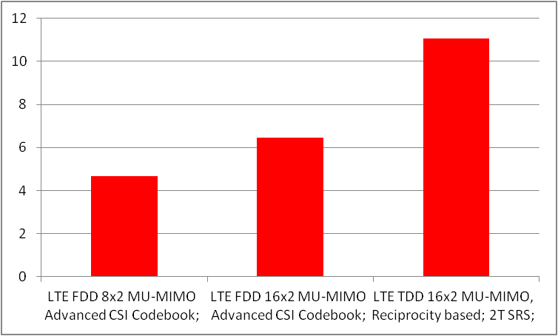
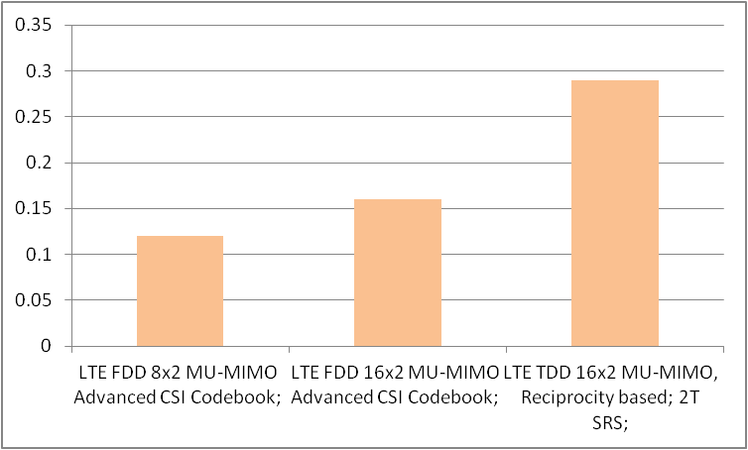
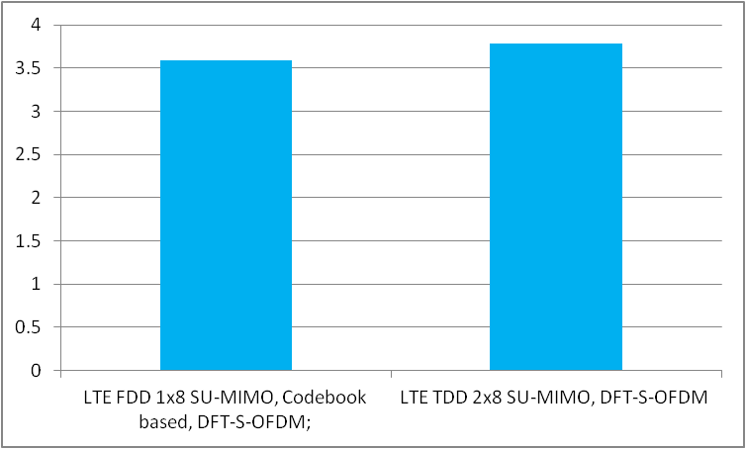
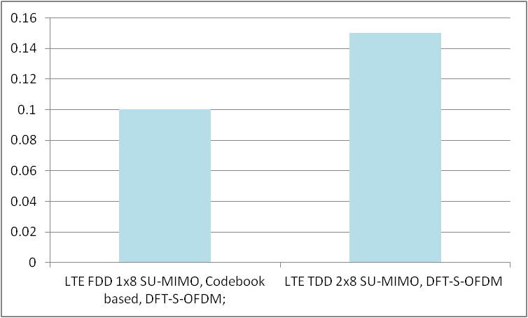
Average and 5th percentile user SE
Various LTE configurations are evaluated for Rural, Indoor and Dense Urban - eMBB. See Section 5.4 of TR37.910 for details
LTE DL average spectral efficiency, Rural (bit/s/Hz/TRxP)
LTE DL 5th percentile user spectral efficiency, Rural (bit/s/Hz)
DL
LTE UL average spectral efficiency, Rural (bit/s/Hz/TRxP)
LTE UL 5th percentile user spectral efficiency, Rural (bit/s/Hz)
UL

Slide 27
User experienced data rate
Contributing technical components :
For both DL and UL, carrier aggregation can be used to boost the user experienced data rate.
For the case of where NR TDD band is in higher frequency range, TDD+SUL can benefit UL user experienced data rate :
Usually TDD band is in higher frequency range than SUL band.
In this case, cell edge users can be allocated to SUL band for uplink transmission where lower propagation loss is observed.
… …
Required bandwidth for user experienced data rate (Dense Urban)
Target | Band | Required BW
DL target = 100 Mbit/s | 4 GHz (NR FDD/TDD; various antenna configuration) | 160~560 MHz BW
UL target = 50 Mbit/s | 4 GHz (NF FDD/TDD; various antenna configuration) | 120 ~ 800 MHz BW
 | 30 GHz (NR TDD, 8x32) + 4 GHz (SUL, 2x32) | 30 GHz: 1.2 GHz BW; 4 GHz: 100 MHz BW
NR fulfills user experienced data rate requirement with its supported bandwidth capability.

Slide 28
Area traffic capacity
Area traffic capacity:
NR Max aggregated bandwidth :
FR1 (15 kHz SCS): 16 CC x 50 MHz/CC = 800 MHz
FR1 (30/60 kHz SCS): 16 CC x 100 MHz/CC = 1.6 GHz
FR2 (120 kHz SCS): 16 CC x 400 MHz/CC = 6.4 GHz
Required bandwidth for area traffic capacity (Indoor hotspot)
Area traffic capacity=
(Average SE) x (Aggregated bandwidth)
/ (Simulation area)
Frequency band | Required BW for DL target of 10 Mbit/s/m²
 | 12TRxP | 36TRxP
4 GHz | 360 MHz ~ 800 MHz | 120 MHz ~ 280 MHz
30 GHz | 600 MHz ~ 1200 MHz | 200 MHz ~ 400 MHz
NR fulfills area traffic capacity requirement with its supported bandwidth capability.

Slide 29
Energy efficiency
Network energy efficiency
Related to always-on transmissions; For NR, SSB period can be configured as long as 160ms
Device energy efficiency
Discontinuous reception (DRX)
BWP adaptation for NR
RRC_INACTIVE state for NR
“SSB set”
NR gNB sleep ratio under low load
periodicity
SSB configuration |  | SSB set periodicity P_{SSB}
SCS [kHz] | Number of SS/PBCH block per SSB set, L | 160ms
15kHz | 1 | 99.38%
 | 2 | 99.38%
30kHz | 1 | 99.84%
 | 4 | 99.38%
120kHz | 8 | 99.69%
 | 16 | 99.38%
240kHz | 16 | 99.69%
 | 32 | 99.38%
Half frame
Half frame
(
5
ms
)
(
5
ms
)
RMSI
SS block
“SSB set”
NR Device sleep ratio for idle / in-active mode
 | Paging cycle N_{PC_RF} *10 (ms) | SCS (kHz) | SSB L | SSB reception time(ms) | SSB cycle (ms) | Number of SSB burst set | RRM measurement time per DRX (ms) | Transition time(ms) | Sleep ratio
RRC-Idle/Inactive | 320 | 240 | 32 | 1 | -- | 1 | 3.5 | 10 | 95.5%
 | 2560 | 15 | 2 | 1 | -- | 1 | 3 | 10 | 99.5%
 | 2560 | 15 | 2 | 1 | 160 | 2 | 3 | 10 | 93.2%
NR fulfills energy efficiency requirement.

Slide 30
Energy efficiency
Network energy efficiency
For LTE, FeMBMS/Unicast-mixed cell and MBMS-dedicated cell can switch off the always-on signals.
Device energy efficiency
Discontinuous reception (DRX)
LTE eNB sleep ratio under low load
Cell type | Sleep ratio
FeMBMS/Unicast-mixed cell | 80%
MBMS-dedicated cell | 93.75%
LTE Device sleep ratio under idle mode
 | Paging cycle N_{PC_RF} *10 (ms) | Synchronization reception time per cycle(ms) | Synchronization cycle(ms) | Number of synchronization | RRM measurement time per DRX (ms) | Transition time (ms) | DL/UL subframe ratio | Sleep ratio
RRC-Idle | 320 | 2 | 10* | 1 | 6 | 10 | 1 | 93.1%
 | 320 | 2 | 10* | 2 | 6 | 10 | 1 | 90.0%
 | 2560 | 2 | 10* | 1 | 6 | 10 | 1 | 99.1%
 | 2560 | 2 | 10* | 2 | 6 | 10 | 1 | 98.8%
LTE fulfills energy efficiency requirement.

Slide 31
Mobility
Mobility is evaluated using MIMO configurations.
Contributing technical components:
NR frame structure:
NR multiple SCSs allow to use larger sub-carrier spacing which is beneficial to combat with Doppler spread.
NR fast CSI feedback and low processing delay helps to combat with time variation of propagation channel.
NR Mobility: Normalized traffic channel link data rate (bit/s/Hz) (Some example configurations; see Section 5.9 of TR37.910 for more details)
InH
(10km/h)
Dense Urban
(30km/h)
Rural 700 MHz
(120km/h)
Rural 700 MHz
(500km/h)
Rural 4 GHz
(120km/h)
Rural 4 GHz
(500km/h)

Slide 32
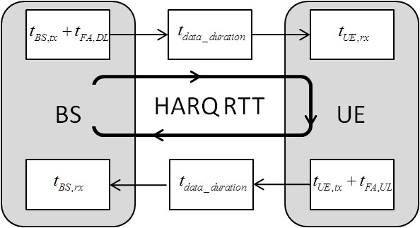
User plane latency
Contributing technical components for NR:
NR frame structure:
NR larger SCSs allow slot duration reduction.
NR Flexible configuration of DL/UL slot:
beneficial to reduce DL or UL waiting time
NR TDD+SUL:
SUL provided continuous uplink transmission opportunity to reduce DL ACK feedback and UL waiting time.
This is especially useful for synchronized network with DL dominant configurations (e.g., DDDSU).
… …
Contributing technical components for LTE:
Short TTI
… …
NR non-slot allows to use less number of OFDM symbol for data transmission, also beneficial to reduce air-interface transmission duration
Resource mapping type B allows immediate data transmission once scheduling resource is available.

Slide 33
User plane latency
Various configurations are evaluated for NR. See TR37.910 for more details.
UP latency for NR uplink
*
**
NR FDD
NR TDD
NR TDD w/ SUL
NR fulfills UL user plane latency requirement for eMBB (4ms) and URLLC (1ms).
* Mapping type B (7 OS)
** Mapping type A (7 OS)

Slide 34
User plane latency
Various configurations are evaluated for NR. See TR37.910 for more details.
UP latency for NR downlink
*
**
NR FDD
NR TDD
NR TDD w/ SUL
NR fulfills DL user plane latency requirement for eMBB (4ms) and URLLC (1ms).
* Mapping type B (7 OS)
** Mapping type A (7 OS)

Slide 35
User plane latency
Various configurations are evaluated for LTE. See TR37.910 for more details.
UP latency for LTE
LTE FDD (DL)
LTE TDD (DL)
LTE FDD (UL)
LTE TDD (UL)
7OS
7OS
7OS
LTE fulfills DL and UL user plane latency requirement for eMBB (4ms) and URLLC (1ms).

Slide 36
Control plane latency
UE
gNB
Contributing technical components for NR include the use of RRC_INACTIVE state, as well as other components similar to UP latency.
For LTE, the control plane latency is improved compared to Rel-10 by the use of RRC connection resume procedure, as well as by recognizing that some processing delay can be further reduced.
1. Delay for RACH Scheduling Period
2. RACH Preamble
3. Processing delay in gNB
4. RA response
5. Processing delay in UE
6. RRC Resume Request
Control plane procedure
7. Processing delay in gNB
NR
LTE
8. RRC Resume
9. Processing delay in UE
Both FDD and TDD can reach as low as around 11ms
Both FDD and TDD can reach the target: 20ms
10. RRC Resume Complete
NR and LTE fulfill control plane latency requirement for eMBB and URLLC (20ms).

Slide 37
Mobility interruption time
NR
LTE
NR fulfills 0ms mobility interruption time in the following scenarios:
Beam mobility
When moving within the same cell, the transmit-receive beam pair of the UE may need to be changed.
gNB can configure different beams for this UE at different slots. It ensures appropriate transmit/receive beam allocation to the UE for continuous data transmission
CA mobility
When moving within the same PCell with CA enabled, the set of configured SCells of the UE may change.
During these procedures, the UE can always exchange user plane packets with the gNB during transitions, because the data transmission between the UE and the PCell is kept.
LTE fulfills 0ms mobility interruption time in the following scenarios:
PCell mobility
See details in Section 5.10 in TR37.910
DC mobility
See details in Section 5.10 in TR37.910.
NR and LTE fulfill mobility interruption time requirement for eMBB and URLLC (0ms).

Slide 38
Reliability
Contributing technical components:
NR frame structure with multiple SCSs is beneficial to reduce the delay.
Slot aggregation and lower MCS is beneficial to ensure the reliability.
4 GHz
NR DL reliability
700 MHz
NR UL reliability
NR fulfills reliability requirement.

Slide 39
Connection density
Connection density for NR, NB-IoT and eMTC are evaluated. See TR37.910 for more details.
Full buffer system level simulation followed by link level simulation; packet arrival rate: 1 packet / 2 hour / device;
LTE connection density
(Channel model A)
NR connection density (1x2 SIMO, 15kHz SCS)
(Channel model B)
ISD (meter) | Required bandwidth (kHz) | Connection density (device/km²) | Target (device/km²)
500 | 180 | 36,000,000 | 1,000,000
1732 | 180 | 1,503,000
ISD=500 m
Connection density (million)
ISD=1732 m
NR fulfills connection density requirement
NB-IoT and eMTC fulfills connection density requirement

Slide 40
Link budget
Link budget
Link budget are provided for NR. See link budget templates for details
Indoor Hotspot (4GHz, TDD)
Dense Urban (4GHz, TDD)
Rural (700MHz, FDD)
Urban Macro-URLLC (700MHz, FDD)
NR link budget for some configurations

Slide 41
Link budget
Link budget are provided for LTE. See link budget templates for details
Rural (700MHz, FDD)
Urban Macro-NB-IoT (700MHz, FDD)
Urban Macro-eMTC (700MHz, FDD)
LTE link budget for some configurations

Slide 42
Table of contents
4
1
2
3
3GPP 5G development and submission towards IMT-2020
3GPP 5G technology for IMT-2020
3GPP 5G self evaluation towards IMT-2020
Conclusion

Slide 43
3GPP Compliance to Service and Spectrum Requirement
 | Service capability requirements | SRIT (NR+LTE) | NR RIT
5.2.4.1.1 | Support for wide range of services Is the proposal able to support a range of services across different usage scenarios (eMBB, URLLC, and mMTC)?: YES/NO Specify which usage scenarios (eMBB, URLLC, and mMTC) the candidate RIT or candidate SRIT can support. | YES The SRIT can support eMBB, URLLC and mMTC usage scenarios. | YES The NR RIT can support eMBB, URLLC and mMTC usage scenarios.
 | Spectrum capability requirements | SRIT (NR+LTE) | NR RIT
5.2.4.2.1 | Frequency bands identified for IMT Is the proposal able to utilize at least one frequency band identified for IMT in the ITU Radio Regulations?:  YES /NO Specify in which band(s) the candidate RIT or candidate SRIT can be deployed. | YES LTE RIT supports the IMT band from 450 MHz to 5925 MHz. NR RIT supports the IMT band from 663 MHz to 5000 MHz. See Section 5.2.3.2.8.3 in characteristics template for details. | YES NR RIT supports the IMT band from 663 MHz to 5000 MHz, including 3.3-3.8; 3.3-4.2 GHz. See Section 5.2.3.2.8.3 in characteristics template for NR RIT for details.
5.2.4.2.2 | Higher Frequency range/band(s) Is the proposal able to utilize the higher frequency range/band(s) above 24.25 GHz?: YES Specify in which band(s) the candidate RIT or candidate SRIT can be deployed. (NOTE 1) | YES NR RIT supports 24.25-27.5; 27.5-28.35; 26.5-29.5; 37-40 GHz. | YES NR RIT supports 24.25-27.5; 27.5-28.35; 26.5-29.5; 37-40 GHz.
NOTE 1 – In the case of the candidate SRIT, at least one of the component RITs need to fulfil this requirement.

Slide 44
3GPP Compliance to Technical Performance Requirement
NR fulfills all the technical requirements.
Peak data rate (Gbit/s)
Peak spectral efficiency (bit/s/Hz)
User experienced data rate (Mbit/s)
Area traffic capacity (Mbit/s/m²)
5th percentile user spectral efficiency (bit/s/Hz)
Rural
InH
Dense Urban
Rural (LMLC)
Dense Urban
Rural (LMLC)
InH
Rural
DL
UL
DL
UL
DL
UL
DL
UL
>1.5x IMT-2020 Req.
NR
DL
UL
Average spectral efficiency (bit/s/Hz/TRxP)
User plane latency (ms)
Energy efficiency
Bandwidth (GHz)
<<1ms
High sleep ratio and long sleep duration
Up to 6.4GHz
eMBB
eMBB
URLLC
URLLC
~6x IMT-Advanced
DL
UL
DL
UL
DL
UL
Control plane latency (ms)
Mobility interruption time (ms)
Reliability (within 1ms)
Connection density (#/km²)
Mobility (bit/s/Hz)
>99.99999%
700MHz
4GHz
0
0
P_{e}<1x10⁻⁶
1,503,000
eMBB
URLLC
eMBB
URLLC
DL
UL
ISD=1732m
Indoor Hotspot
Dense Urban
Rural (120km/h; 500km/h)

Slide 45
3GPP Compliance to Technical Performance Requirement
LTE fulfills the technical performance requirements for required number of test environments.
Peak data rate (Gbit/s)
Peak spectral efficiency (bit/s/Hz)
User experienced data rate (Mbit/s)
Area traffic capacity (Mbit/s/m²)
5th percentile user spectral efficiency (bit/s/Hz)
InH
Dense Urban
Rural
Rural
(LMLC)
InH
Dense Urban
Rural
Rural
(LMLC)
DL
UL
DL
UL
User plane latency (ms)
LTE
DL
UL
Average spectral efficiency (bit/s/Hz/TRxP)
0.73
Energy efficiency
Bandwidth (GHz)
High sleep ratio and long sleep duration
Up to 640MHz
eMBB
eMBB
URLLC
URLLC
DL
UL
DL
UL
DL
UL
Control plane latency (ms)
Mobility interruption time (ms)
Reliability (within 1ms)
Connection density (#/km²)
Mobility (bit/s/Hz)
700 MHz
20
20
0
0
Not evaluated in TR37.910
2,335,000
eMBB
URLLC
eMBB
URLLC
ISD=1732m
Indoor Hotspot
Dense Urban
Rural (120km/h; 500km/h)

Slide 46
Conclusion
Usage scenario | Sub-items | Evaluation method | Test environment
 |  |  | eMBB |  |  | mMTC | URLLC
 |  |  | Indoor hotspot | Dense urban | Rural | Urban macro | Urban macro
eMBB | Peak data rate | Analysis | ✓ | ✓ | ✓
 | Peak spectral efficiency | Analysis | ✓ | ✓ | ✓
 | User experienced data rate | Analysis, or SLS (for multi-layer) |  | ✓
 | 5th percentile user spectral efficiency | SLS | ✓ | ✓ | ✓
 | Average spectral efficiency | SLS | ✓ | ✓ | ✓
 | Area traffic capacity | Analysis | ✓
 | Energy efficiency | Inspection | ✓ | ✓ | ✓
 | Mobility | SLS + LLS | ✓ | ✓ | ✓
eMBB, URLLC | User plane latency | Analysis | ✓ | ✓ | ✓ |  | ✓
 | Control plane latency | Analysis | ✓ | ✓ | ✓ |  | ✓
 | Mobility interruption time | Analysis | ✓ | ✓ | ✓ |  | ✓
URLLC | Reliability | SLS + LLS |  |  |  |  | ✓
mMTC | Connection density | SLS + LLS, or Full SLS |  |  |  | ✓
General | Bandwidth and Scalability | Inspection | ✓ | ✓ | ✓ | ✓ | ✓
Both 5G SRIT and NR RIT are compliant with all IMT-2020 requirements

Slide 47
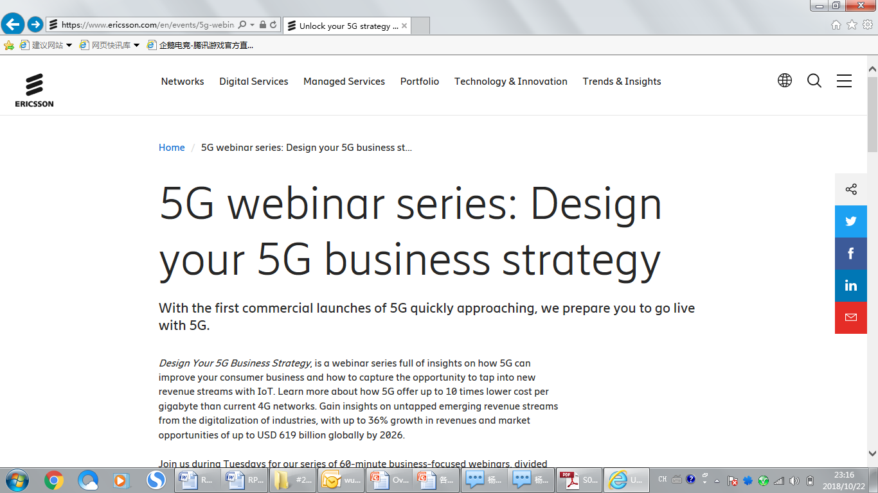

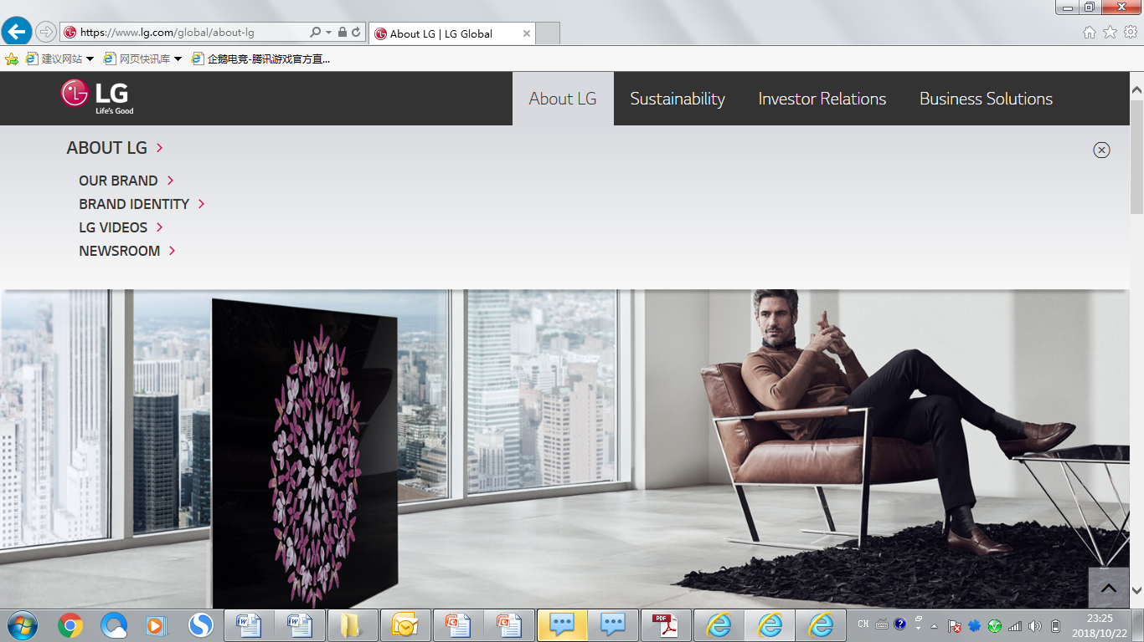

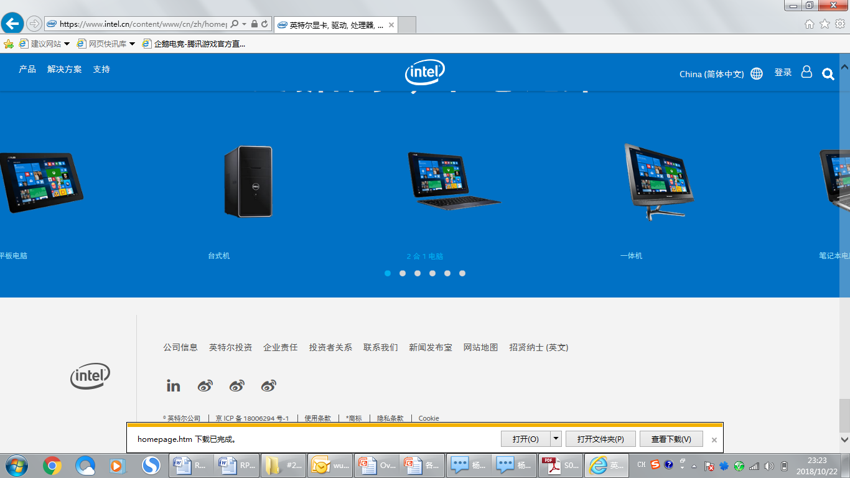




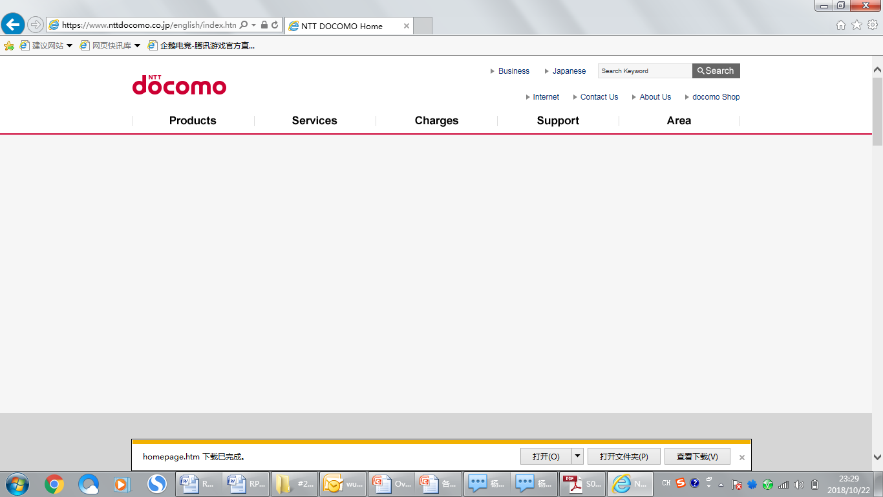




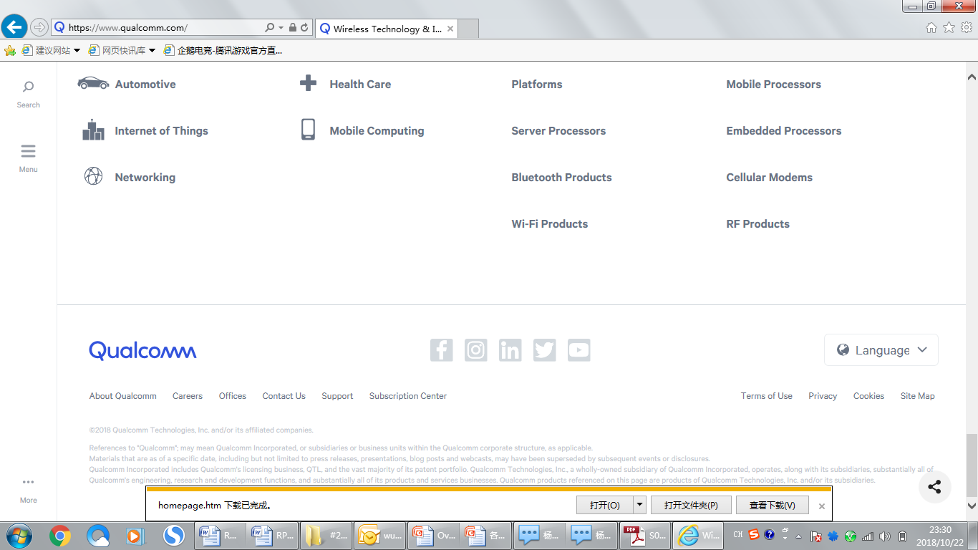




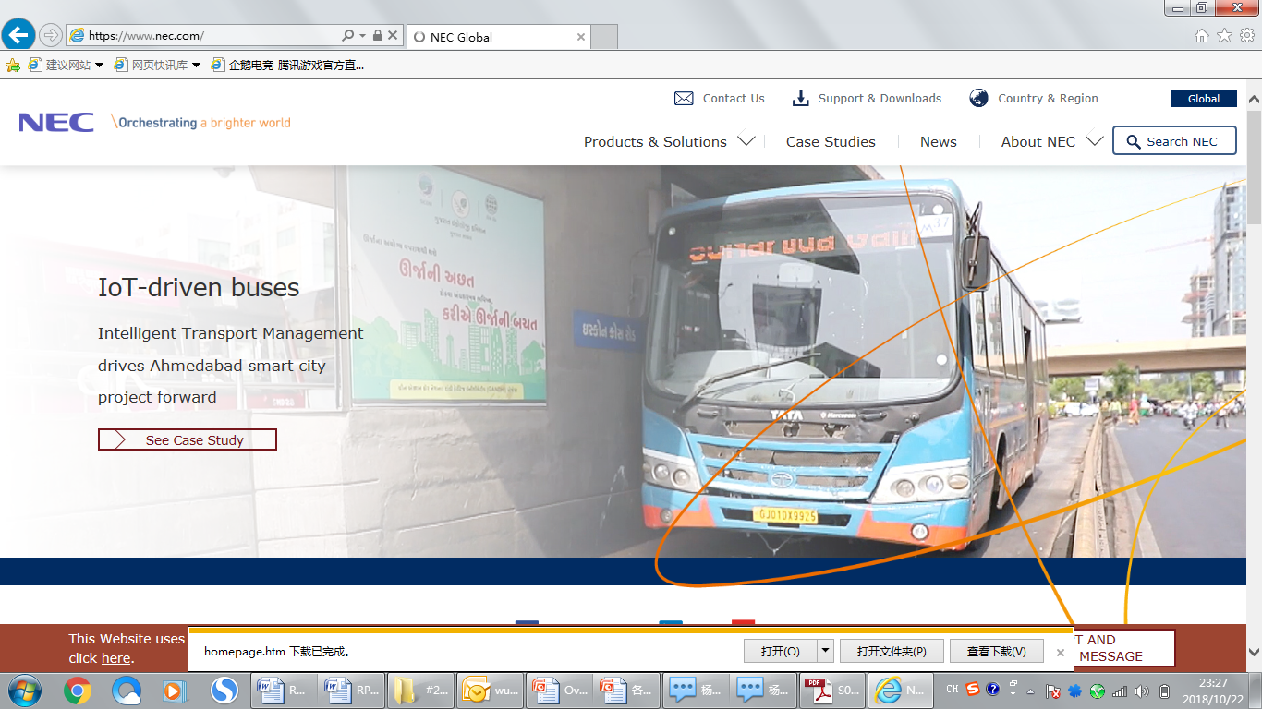



Acknowledgement

Slide 48
Thank you!

